Slide 1
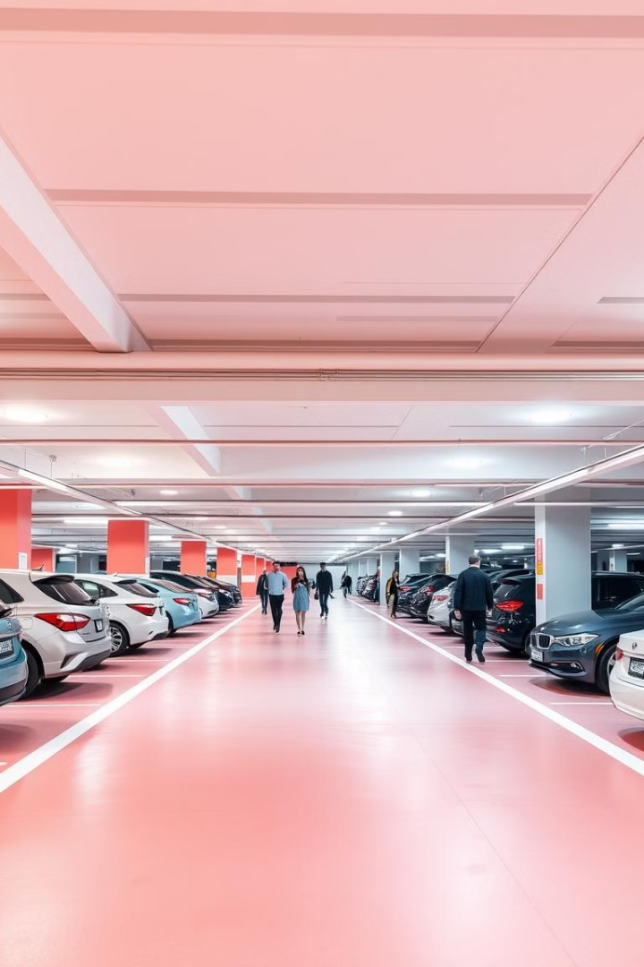
MATLAB-Based System to Calculate Manual Car Parking Fees
Traditional parking fee management methods often result in inefficiencies and customer dissatisfaction. This presentation introduces an innovative, manual parking fee system powered by MATLAB programming. By streamlining the fee calculation and payment processes, this system aims to enhance operational efficiency and significantly improve the overall parking experience for both customers and operators.
Group Members:
Ishika Modi
Devanshi Upadhayay
Devank Sarad
Ansh Yadav

Slide 2
Limitations of Manual Fee Management
Error-prone
Time-consuming
Inflexible
Customer Dissatisfaction
Manual calculations are prone to human error, leading to inaccurate charges and potential disputes.
Manual processes can be slow and inefficient, creating long queues and frustrating drivers.
Manual systems are inflexible, struggling to adapt to dynamic pricing models and complex scenarios.
Long wait times, inaccurate charges, and a lack of transparency can lead to negative customer experiences.

Slide 3
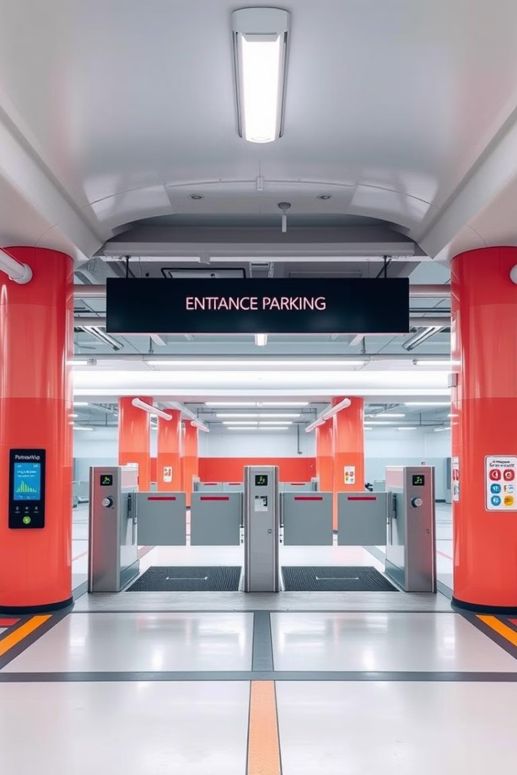
Introducing an Manual Parking Fee System
1
Manual
Calculation
2
Flexible Pricing Models
The system relies on MATLAB to manually calculate fees based on entry and exit times.
It supports a variety of pricing models, including fixed rates, time-based rates, and dynamic pricing.
3
Real-time Feedback
4
Scalable Design
Provides instant feedback to users, displaying the calculated fee and payment options.
Easily adapts to different parking garage sizes and configurations.

Slide 4
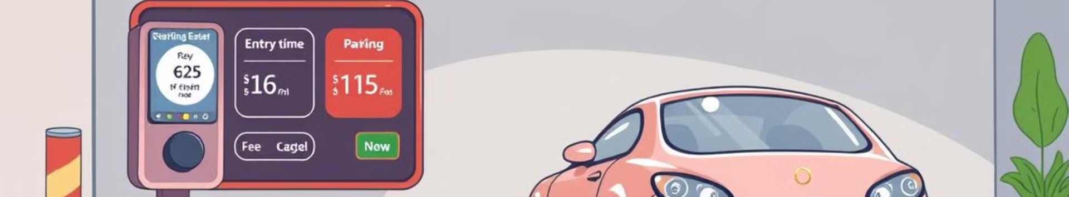
Key Features of the Manual System
Fixed Rate
Dynamic Pricing
Offers a fixed rate for a specific period, such as hourly or daily rates.
Adjusts prices based on demand, time of day, or other factors, optimizing revenue and parking management.
1
2
3
Time-Based Rate
Charges based on the duration of stay, with varying rates for different time periods.

Slide 5
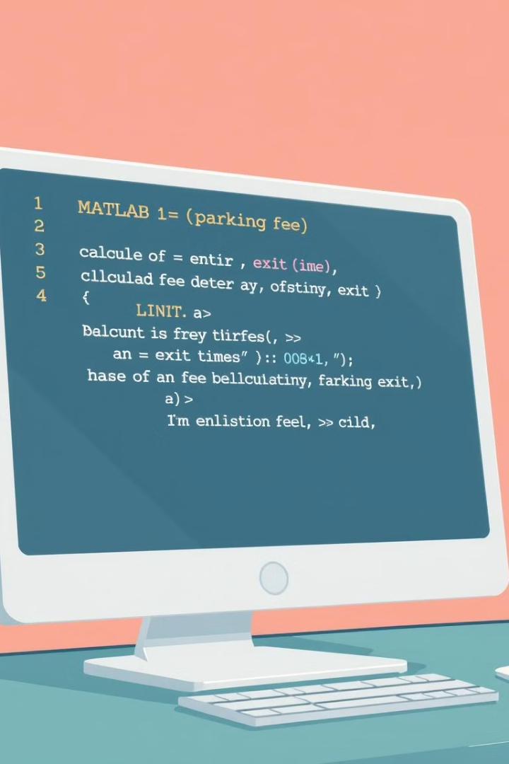




Accurate Fee Calculation
Time-based Fees
Formula-Driven
The system calculates fees based on the exact time the vehicle enters and exits the garage.
The system uses a predefined formula to calculate fees based on the duration of the stay.
Error Reduction
Transparency
The automated system eliminates human error, ensuring accurate and consistent fee calculations.
Displays the calculated fee clearly to the user, promoting transparency and trust.

Slide 6
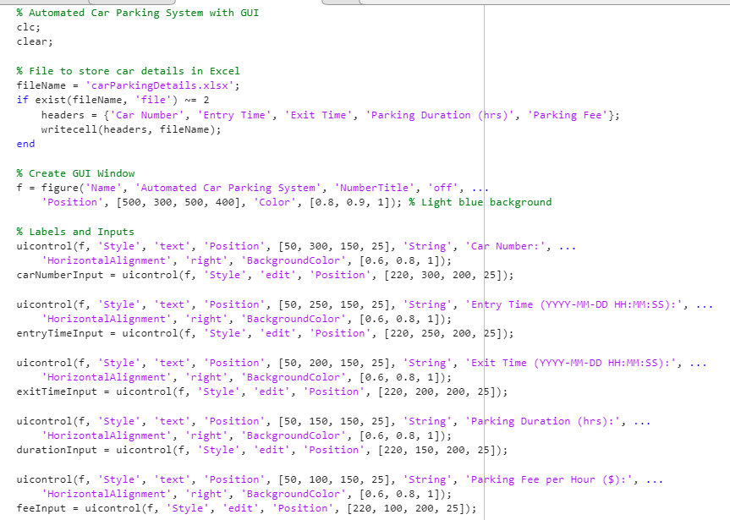
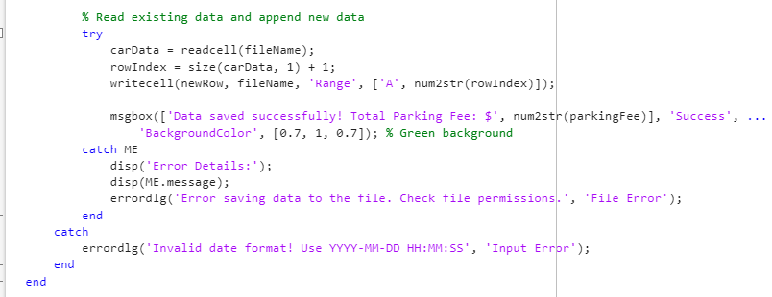
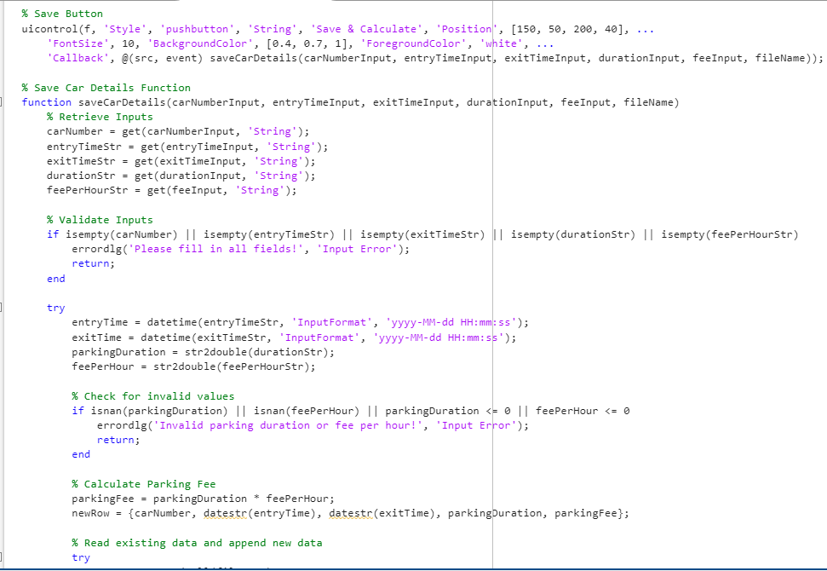
Program and Functions to be Used

Slide 7
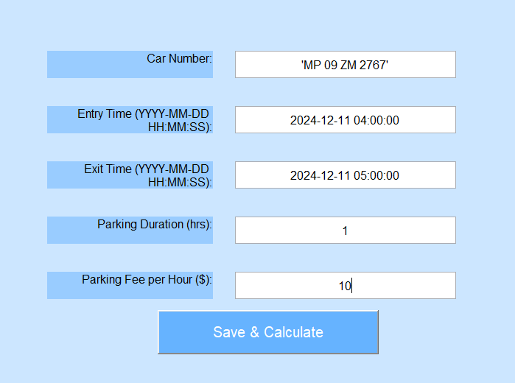
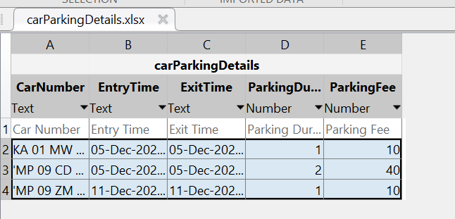

Slide 8




Real-Time User Feedback and Transparency
1
Real-time Display
2
Fee Breakdown
Displays the calculated fee and the rationale behind it, promoting transparency.
Payment Options
3
Offers various payment methods, such as credit card, debit card, or mobile wallet.
Receipt Generation
4
Provides a digital or printed receipt with all relevant details for customer records.

Slide 9
THANK YOU!!

